Slide 1
Employee Data Analysis using Excel
STUDENT NAME: Preethi G
REGISTER NO:BBBCC85C9908F83A22C470C5C0E2714A , 312208737
DEPARTMENT: BCom General
COLLEGE: Meenakshi college for women's

Slide 2
PROJECT TITLE
Employee Performance Analysis Based On Departments, Employee
Type And FTE using Excel

Slide 3


AGENDA
Problem Statement
Project Overview
End Users
Our Solution and Proposition
Dataset Description
Modelling Approach
Results and Discussion
Conclusion
3/21/2024 Annual Review

Slide 4

PROBLEM STATEMENT
FTE is used to allocate employees to departments, depending on each department's workload. Management and HR can evaluate projects, job descriptions or really any employment need and assess the number of FTE needed to get the job done.

Slide 5

PROJECT OVERVIEW
Employee analysis involves
examining various aspects of the
workforce to gain insights that
can help in decision - making,
improving efficiency, and
enhancing employee satisfaction
.

Slide 6

WHO ARE THE END USERS?
● HUMAN RESOURCE DEPARTMENTS
● MANAGEMENT AND LEADERSHIP
● TEAM LEADERS AND SUPERVISORS
● EMPLOYEES
● EXECUTIVE LEADERSHIP
● BUSINESS ANALYSTS
● RECRUITERS

Slide 7

OUR SOLUTION AND ITS VALUE PROPOSITION
FILTERING- REMOVE VALUES
PIVOT TABLE - SUMMARY OF
EMPLOYEE PERFORMANCE
BAR DIAGRAM - FINAL REPORT

Slide 8
Dataset Description
● EMPLOYEE DATA SET- NAN MUDHALVAN PORTAL
● 9 FEATURES IN EXCEL:
EMPLOYEE ID- ALPHANUMERIC(TEXT)
NAME- ALPHABETICAL(TEXT)
GENDER- ALPHABETICAL(TEXT)
DEPARTMENT - ALPHABETICAL(TEXT)
SALARY - NUMERICAL
START DATE - ALPHANUMERIC(TEXT)
FTE- NUMERICAL
EMPLOYEE TYPE- ALPHABETICAL(TEXT)
EMPLOYEE LOCATION- ALPHABETICAL(TEXT)
● 3 FEATURES USED:
DEPARTMENT - ALPHABETICAL(TEXT)
FTE- NUMERICAL
EMPLOYEE TYPE- ALPHABETICAL(TEXT)

Slide 9

THE "WOW" IN OUR SOLUTION
Data analytics allow smaller companies to make decisions that help them compete with larger enterprises for market share. With the right insights, businesses can become more innovative and find ways to offer better prices and customer service.
3/21/2024 Annual Review
9

Slide 10
MODELLING
● STEP -1
DOWNLOAD THE EMPLOYEE DATASET
AND OPEN THE EMPLOYEE DATASET IN EXCEL.
● STEP -2
SELECT THE ENTIRE DATA AND CLICK
ON DATA AND CLICK ON FILTER OPTION.
● STEP -3
FILTER FTP FROM A TO Z ORDER.
● STEP -4
SELECT THE ENTIRE DATA AND CLICK
ON INSERT AND CLICK ON PIVOT TABLE TO
CREATE PIVOT TABLE.
10

Slide 11
● STEP -5
DRAG THE NEEDED DATA AND CREATE A
PIVOT TABLE.
● STEP -6
SELECT THE PIVOT TABLE AND CLICK ON
INSERT.
● STEP-7
NOW CLICK ON THE CHART THAT YOU
WANT.
● STEP -8
THE CHART IS CREATED

Slide 12
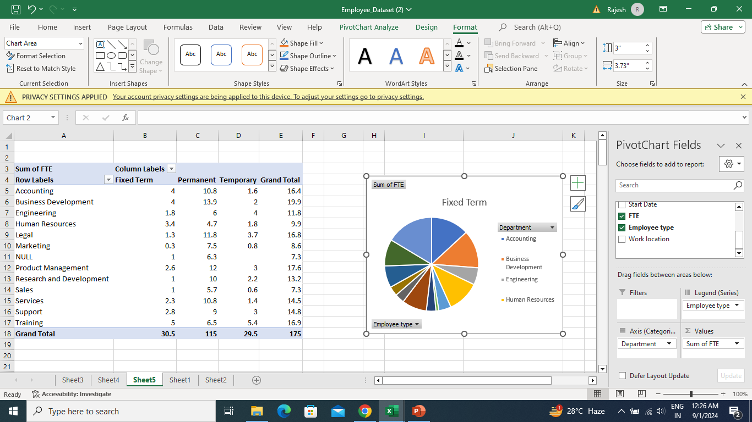
RESULT 1.TABLE
12

Slide 13
2. BAR DIAGRAM

Slide 14
Conclusion
Datasets play a vital role in every facet of our lives. In this modern day, all devices are made to collect data and create datasets for advertisers/businesses to personalize their advertisements to consumers.

